Slide 1
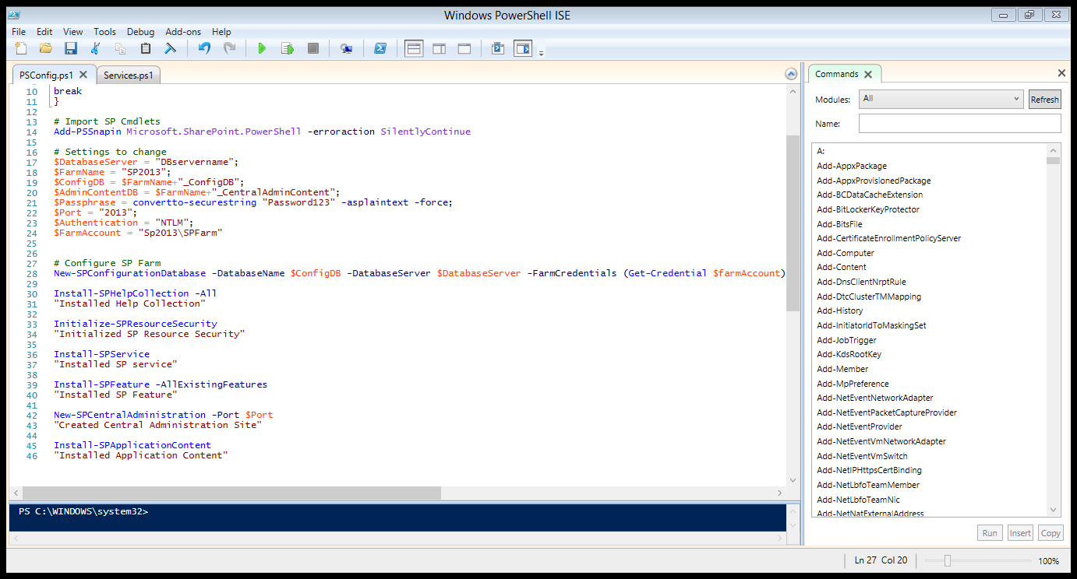
Open PSConfig.ps1 and modify the settings for the accounts set forth in the documentation then run the script.

Slide 2
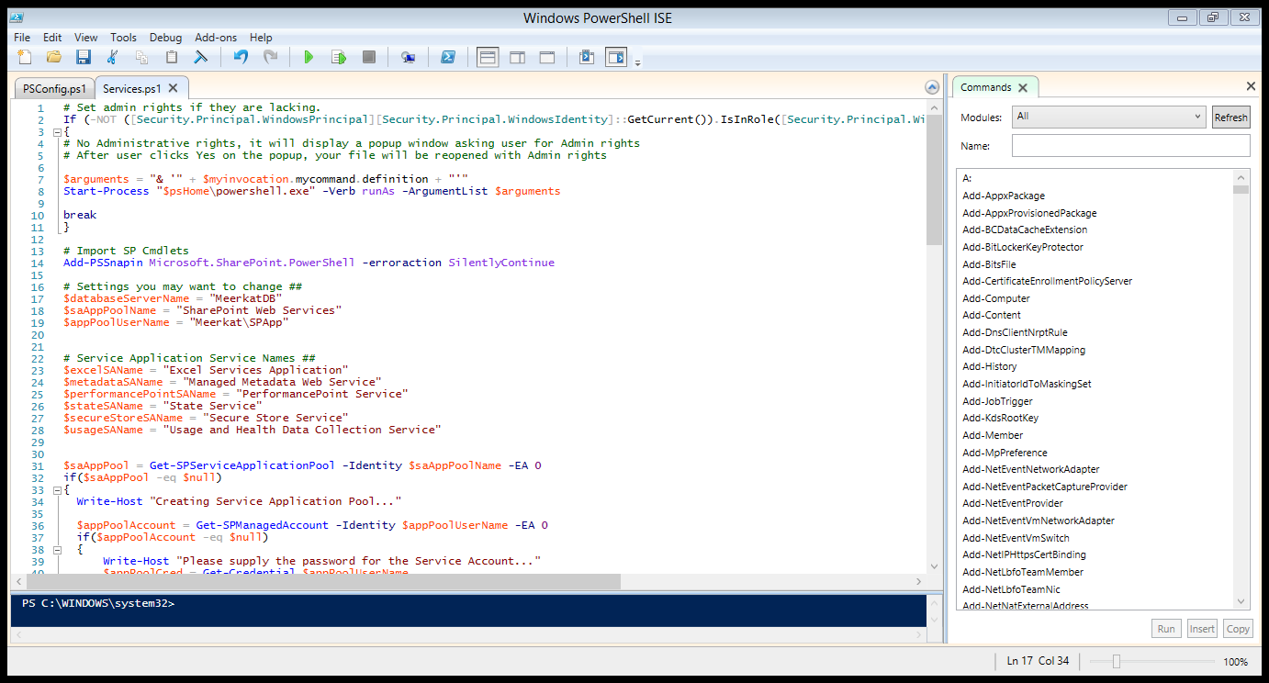
Modify the settings for the DB server and the SP App Pool and its credentials then run the script.

